Slide 1
Getting started with ICANN

Slide 2


Slide 3
Internet Corporation for assigned names and numbers

Slide 4
What does ICANN do?

Slide 5
1. Through its contracts with registries and registrars ICANN provides a consistent and stable environment for the domain name system, hence the Internet.

Slide 6
2.ICANNcoordinates how IP addresses are supplied to avoid repetition or clashes.
*ICANN is the central repository for IP addresses, from which ranges are supplied to regional registries who in turn distribute them to network providers.

Slide 7
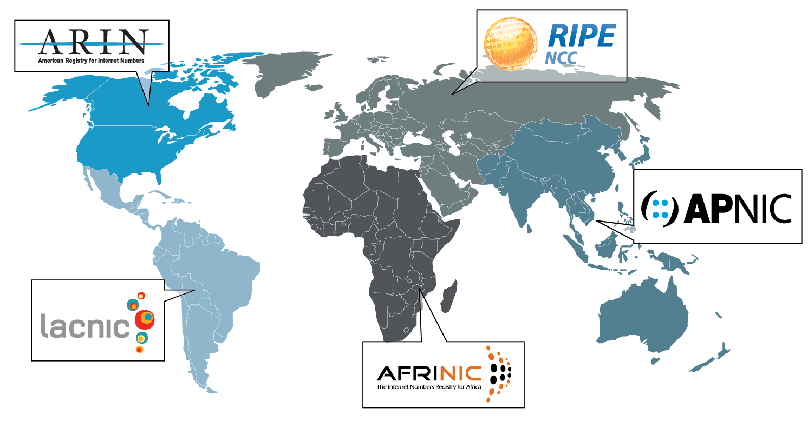

Slide 8

African Network Information Center- AfriNIC- covering the African continent
The five RIRs are:

Slide 9

Asia Pacific Network Information Centre -APNIC- covering the Asia-Pacific region including Japan, Korea, China and Australia

Slide 10

American Registry for Internet Numbers-ARIN-covering Canada, some Caribbean and North Atlantic islands and the United States

Slide 11

Latin American and Caribbean Internet Addresses Registry -LACNIC- covering Latin America and Caribbean

Slide 12

Réseaux IP Européens -RIPE NCC-covering Europe, the Middle East and parts of Asia

Slide 13
3. The operators of the root servers remain largely autonomous, but at the same time work with one another and with ICANN to make sure the system stays up-to-date with the Internet’s advances and changes.

Slide 14
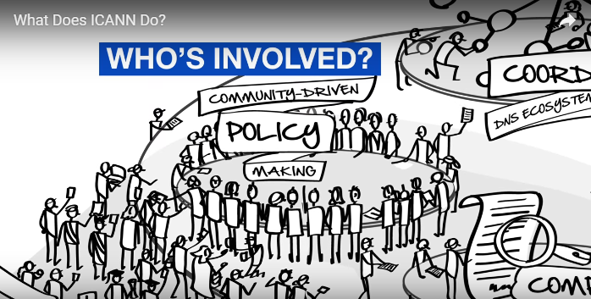

Slide 15
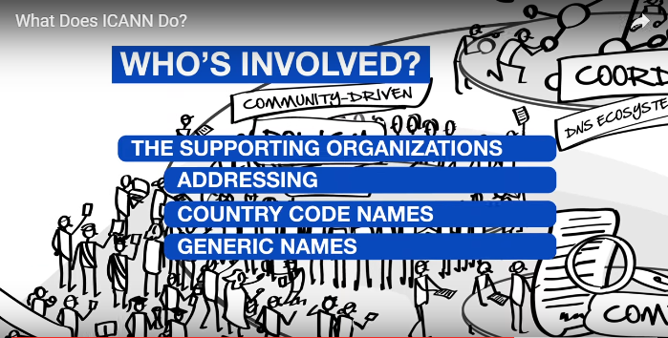

Slide 16
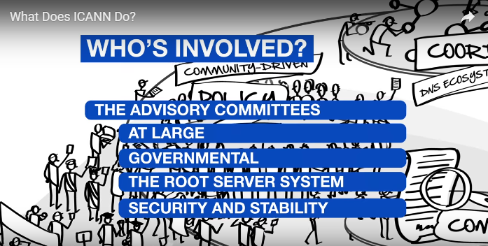

Slide 17
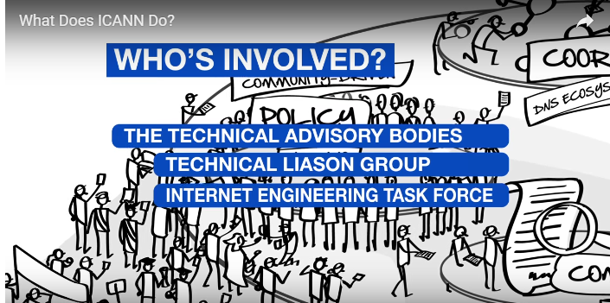

Slide 18
The Board of Directors
1.Make final decisions
2. Made up of 21 members: 15 of which have voting rights and 6 are non-voting liaisons

Slide 19
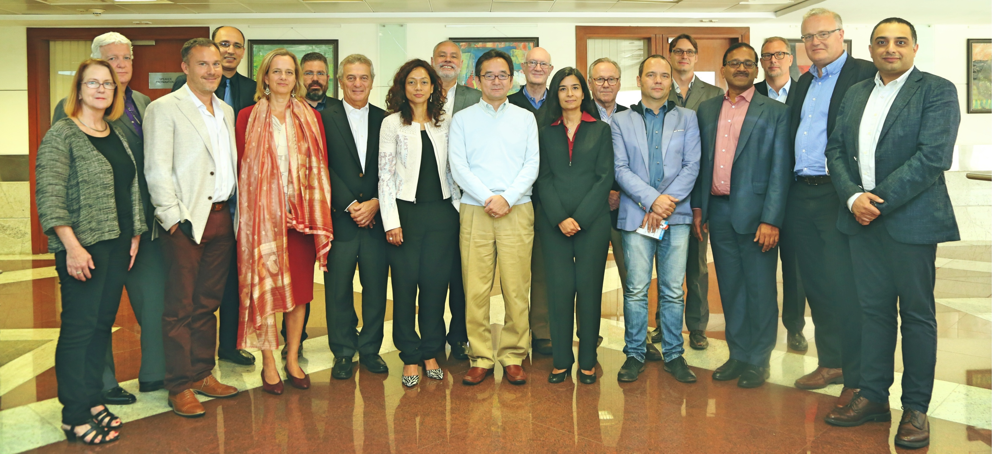

Slide 20
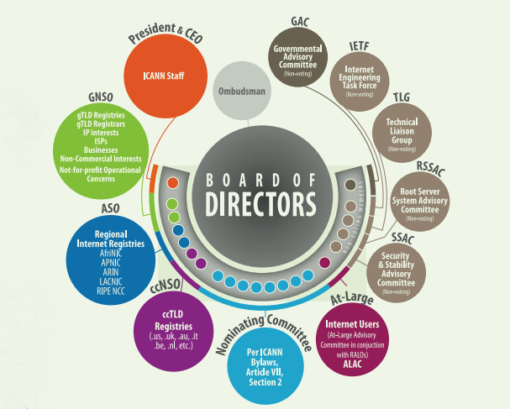

Slide 21


Slide 22
https://www.youtube.com/watch?v=Lk5j25nmZKY
https://www.youtube.com/watch?v=D__mAX-2sXo

Slide 23

How does ICANN work?

Slide 24


Slide 25
Consensus-driven
policy
Multi-stakeholder model

Slide 26

What has ICANN accomplished?

Slide 27
What Has ICANN Accomplished?
ICANN established market competition for generic domain name (gTLD) registrations resulting in a lowering of domain name costs by 80% and saving consumers and businesses over US$1 billion annually in domain registration fees.

Slide 28
What Has ICANN Accomplished?
ICANN implemented an efficient and cost-effective Uniform Domain Name Dispute Resolution Policy (UDRP), which has been used to resolve thousands of disputes over the rights to domain names.

Slide 29
What Has ICANN Accomplished?
Working in coordination with the appropriate technical communities and stakeholders, ICANN adopted guidelines for the deployment of Internationalized Domain Names (IDN), opening the way for registration of domains in hundreds of the world's languages.

Slide 30
What Has ICANN Accomplished? ICANN and NTIA jointly completed deployment of Domain Name System Security Extensions (DNSSEC) for the root zone in July 2010. These extensions make certain kinds of cyberfraud much more difficult to perpetrate. As of 30 June 2011, 70 TLDs had adopted DNSSEC, including two of the largest TLDs -- .com and .de.

Slide 31
What Has ICANN Accomplished?
ICANN created the New gTLD Program, so that any established entity in the world can apply to operate its own top-level domain.

Slide 32
What Has ICANN Accomplished?
The world broadly accepts ICANN as the place to work out Internet governance policies. As 2011 ended, the Governmental Advisory Committee represented 109 nations (plus the European Union and the Vatican). The Country Code Names Supporting Organization (ccNSO) represented more than 120 country code domains. The At-Large Advisory Committee represented 134 At-Large Structures (ALSes) from all geographic regions.

Slide 33
ICANN Strategic Plan for 2016-2020

Slide 34
https://www.youtube.com/watch?v=Jaf1Cy-tAQ4

Slide 35
Final Quiz

Slide 36
1.Which is our regional Internet registry?
1.ARIN
2.LACNIC
3.RIPE NCC
4.APNIC

Slide 37
2.Which one is a technical advisory body?
1.Address supporting organization
2.Security and Stability Advisory Committee
3.Internet Engineering Task Force
4.all of the above mentioned

Slide 38
3.Which of the following committees represent average Internet users’ interests?
1.Governmental Advisory Committee (GAC)
2.Аt large Advisory Committee (ALAC)
3.Security and Stability Advisory Committee (SSAC)
4.Root Server System Advisory Committee (RSSAC) the interests of average Internet users?

Slide 39
4.Which of the followings advises the ICANN Board of Directors on policy issues relating to the allocation and management of IP addresses?
1.Root Server System Advisory Committee
2.Address Supporting Organization
3.IANA
4.Country Code Names Supporting Organization

Slide 40
5.Which of the followings develop and recommend policies concerning the Internet’s technical management within their areas of expertise?
1.Supporting Organizations
2.Advisory Committees
3.IANA
4.Technical Liaison Group

Slide 41
6.Which of the followings is a formal advisory body made up of representatives from the Internet Community?
1.Advisory Committee
2.Internet Engineering Task Force
3.Board of Directors
4.RIPE NCC

Slide 42
Thank you…

